Slide 1
U.S. Copyright Law
INFO 4940/5940
Instructor: Mike Priehs
Welfare Theory & Cultural Theory
February 19, 2025

Slide 2
Last Week’s Topics
Fairness Theory
  Law should give authors what they deserve; hard work should be rewarded and authors should retain control of the fruits of their labor
Personality Theory
  Protecting the emotional bond between the artist and their creation; focus on moral rights

Slide 3
Welfare Theory
Introduction

Slide 4
Welfare Theory
Foundation is utilitarianism
  Government and law should be organized to promote the greatest good for the greatest number
Philosophy: Jeremy Bentham & John Stuart Mill

Slide 5
How is it different?
Forward-Thinking
  Seeks to craft the law in a way that will encourage people in the future to focus on increased overall happiness or welfare
Collective rather than Individual
  Focuses on welfare of society as a whole rather than serving needs of individual members
The Public Good

Slide 6

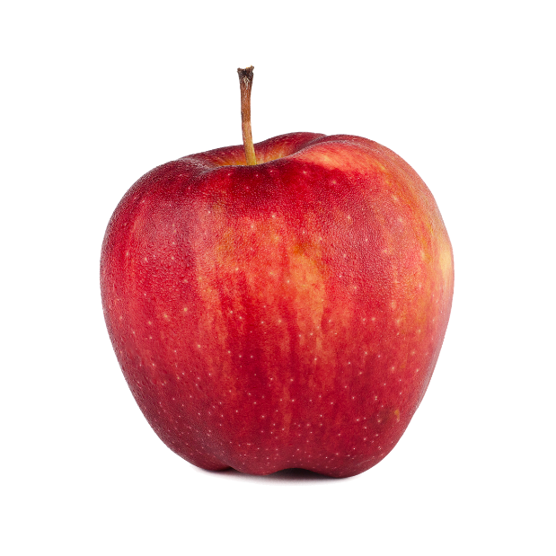
What is a Public Good?
Non-rivalrous
Non-excludable
v.

Slide 7
The Public Good Problem = Underproduction?
Reasons public goods may be underproduced:
  High cost of creation
  High uncertainty of success
    What if it doesn’t work? What if there is no demand for the good?
  Ease of reverse engineering
  Positive externalities from the public good
    People who don't pay for the good still experience positive effects from its existence

Slide 8
Public Goods: Encouraging Production
Mitigating the problem of public goods being underproduced:
  Lead time protects first mover
  Customs or extralegal norms protect first mover
  Opportunities for increasing excludability through self-help
  Alternative motivations for production
  Philanthropy

Slide 9
Public Goods: Government Solutions
Government provides the good
Government selects and subsidizes private innovators
Government issues prizes to successful private producers
Legal reinforcement of self-help strategies
Government protects producers against competition

Slide 10
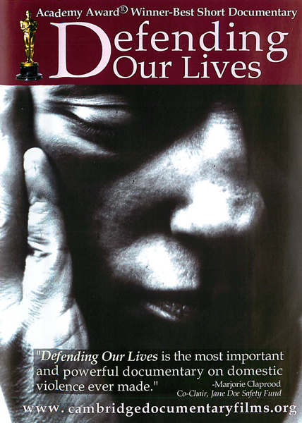
Example
Cambridge Documentary Films (CDF)
  Producer of high-quality, short documentaries
  “Defending Our Lives” – a documentary about domestic violence
  Won the Academy Award for Short Documentary in 1993

Slide 11
Hypothetical
CDF wants to make money by distributing copies of the film in DVD format
How much should CDF charge for each copy?

Slide 12
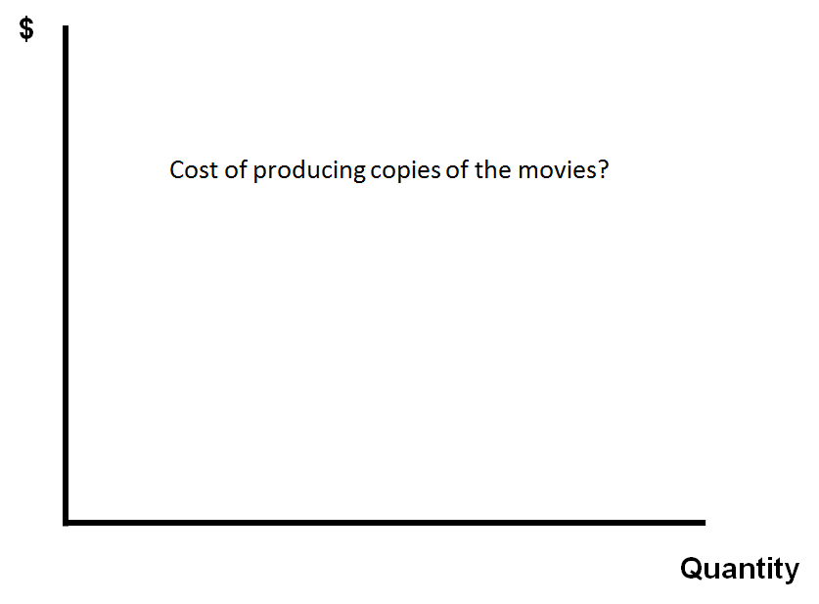

Slide 13
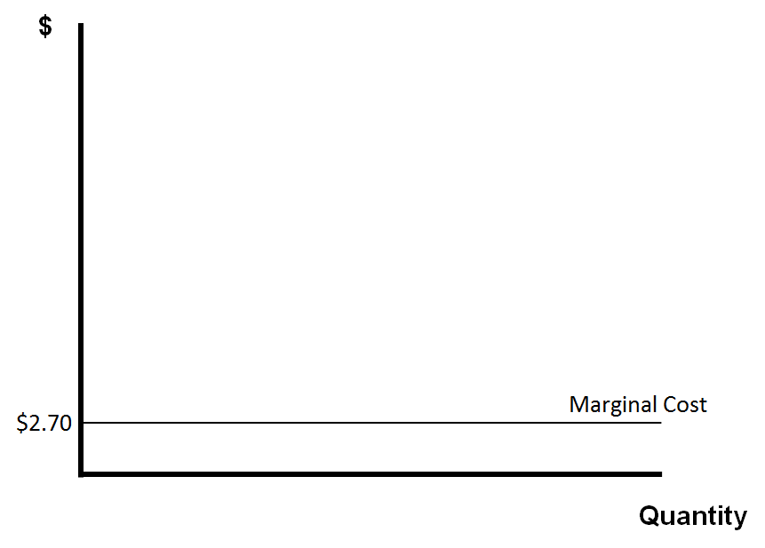

Slide 14
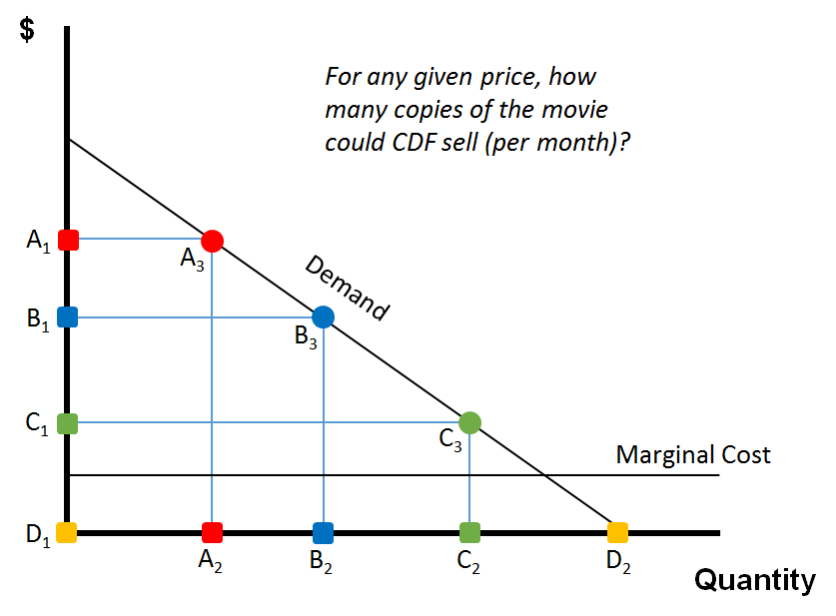

Slide 15
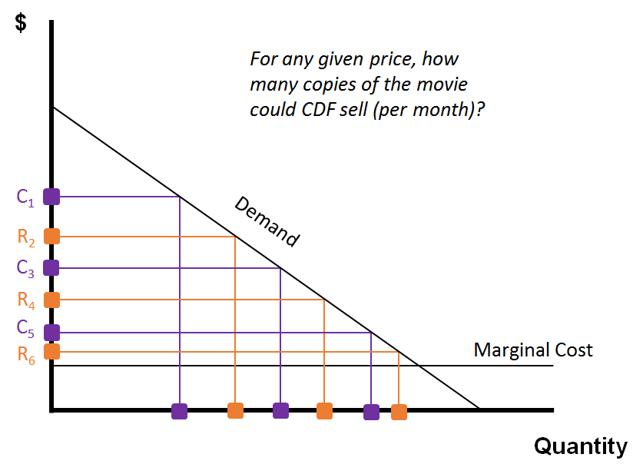

Slide 16
Basic Principle of Welfare Theory
Unless creators can recoup the costs of their creations, they won’t produce those creations in the first place
  The way law enables them to recoup costs is to suppress competition in the creation and distribution of the work
  Absence of competition enables creators to price copies much higher than the costs of making and distributing
  This prices out consumers, though we tolerate it in order to stimulate creativity in the first place

Slide 17
General Applications / Implications
From a utilitarian standpoint, copyright is a necessary evil
  Copyrights should not be used in contexts in which they’re not necessary.
  Copyright protection should not be extended to kinds of innovations that would be produced in optimal numbers without those protections

Slide 18
General Applications / Implications
Disaggregation of the copyright system; rules differ based on specific types of innovations
  Public goods problem varies by type of work
  E.g. Duration of copyright terms
    Life of author + 70 years
    Per Welfare Theory, this duration should change based on type of work

Slide 19
General Applications / Implications
Guideline for comparing the relative desirability of the various rights that we might give to copyright owners
  We should look carefully at the ratio between incentives generated by each entitlement and the social welfare losses that come with it

Slide 20
Public Goods: Government Solutions
Government provides the good
Government selects and subsidizes private innovators
Government issues prizes to successful private producers
Legal reinforcement of self-help strategies
Government protects producers against competition
What are the advantages and disadvantages of copyright as a solution to the public goods problem?

Slide 21
Advantages of Copyright
Relies on market to drive research toward areas of high social value
Relies on private party knowledge of the costs of R&D, marketing, etc.
Imposes costs of innovation upon initial users of the innovations
Competition in the quest for profits leads to fast, focused research

Slide 22
Disadvantages of Copyright
Deadweight loss
Administrative and litigation costs
Impediments to cumulative innovation
Rent dissipation
Ineffectiveness in digital environment

Slide 23
Cultural Theory
Introduction

Slide 24
Cultural Theory
Contends that the law should cultivate a just and attractive culture. This theory tends towards paternalism, as it presumes to encourage works for the betterment of humankind rather than limiting the scope to those works for which there is a current demand. Like welfare theory, cultural theory is prospective: the law should prompt individuals to behave in ways that will create a better society in the future.
https://library.osu.edu/site/copyright/2014/05/09/theories-of-copyright/

Slide 25
Cultural Theory
Key Idea:
Human nature causes people to flourish more under some conditions than under other conditions
Social and political institutions should be organized to facilitate that flourishing

Slide 26
What Conditions Enable People to Flourish?
Life
Health
Autonomy
Engagement
Self-Expression
Competence
Connection
Privacy

Slide 27
Culture that Enables People to Flourish
Cultural Diversity
Rich Artistic Tradition
Education
Active Citizenship
Anything Else?

Slide 28
Possible Legal Reform
Education
Idea/Fact/Expression Distinction
Fair Use
Moral Rights
Libraries
Formalities
Compulsory Licensing
Differential Pricing
Supplementary Government Funding
Alternative Compensation System for Recorded Entertainment
Traditional Knowledge
Trademark Reform
Patent Reform

Slide 29
Sony v. Universal (1984): “Betamax Case”
“The situations in which fair use is most commonly recognized are listed in section 107 itself. Fair use may be found when a work is used “for purposes such as criticism, comment, news reporting, teaching, … scholarship, or research.” … Each of these uses reflects a common theme. Each is a productive use resulting in some added benefit to the public beyond that produced by the first author’s work. The fair use doctrine, in other words, permits works to be used for “socially laudable purposes”. I am aware of no case in which the reproduction of a copyrighted work for the sole benefit of the user has been held to be fair use.”
-Justice Blackmun’s dissenting opinion

Slide 30
Advantages
For consumers:
  Cost savings, unlimited access to recorded media, set of cultural products available to them would be larger and more diverse, increased opportunities for creative reuse of cultural products
For creators:
  Opportunities to distribute directly to consumers, increased income
For public:
  Decreased litigation, decreased law-breaking

Slide 31
Disadvantages
Cross subsidies
Moral rights concerns
Discretionary governmental power
Leakage across national boundaries

Slide 32
Weaknesses of Cultural Theory
Issues with Paternalism
The shape of our culture determined by government officials

Slide 33
Question?
Thanks!

